Slide 1
OSI Network Layer

Slide 2
Network Layer
The network Layer controls the operation of the subnet. The main aim of this layer is to deliver packets from source to destination across multiple links (networks).
If two computers (system) are connected on the same link, then there is no need for a network layer.
It routes the signal through different channels to the other end and acts as a network controller.
It also divides the outgoing messages into packets and to assemble incoming packets into messages for higher levels.
In broadcast networks, the routing problem is simple, so the network layer is often thin or even non-existent.

Slide 3
Functions of Network Layer
It translates logical network address into physical address. Concerned with circuit, message or packet switching.
Routers and gateways operate in the network layer. Mechanism is provided by Network Layer for routing the packets to final destination.
Connection services are provided including network layer flow control, network layer error control and packet sequence control.
Breaks larger packets into small packets.

Slide 4
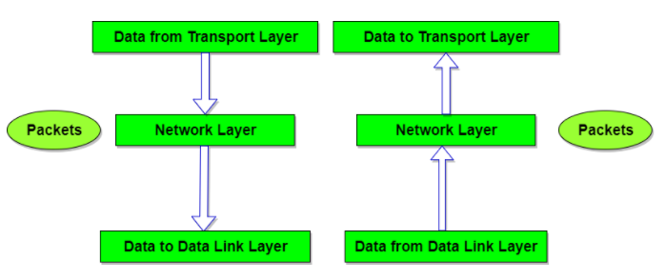

Slide 5
Design Issues with Network Layer
A key design issue is determining how packets are routed from source to destination.
Routes can be based on static tables that are wired into the network and rarely changed
They can also be highly dynamic, being determined anew for each packet, to reflect the current network load.
If too many packets are present in the subnet at the same time, they will get into one another's way, forming bottlenecks.
The control of such congestion also belongs to the network layer.
Moreover, the quality of service provided(delay, transmit time, jitter, etc) is also a network layer issue.
When a packet has to travel from one network to another to get to its destination, many problems can arise such as:
  The addressing used by the second network may be different from the first one.
  The second one may not accept the packet at all because it is too large.
  The protocols may differ, and so on.
It is up to the network layer to overcome all these problems to allow heterogeneous networks to be interconnected.

Slide 6
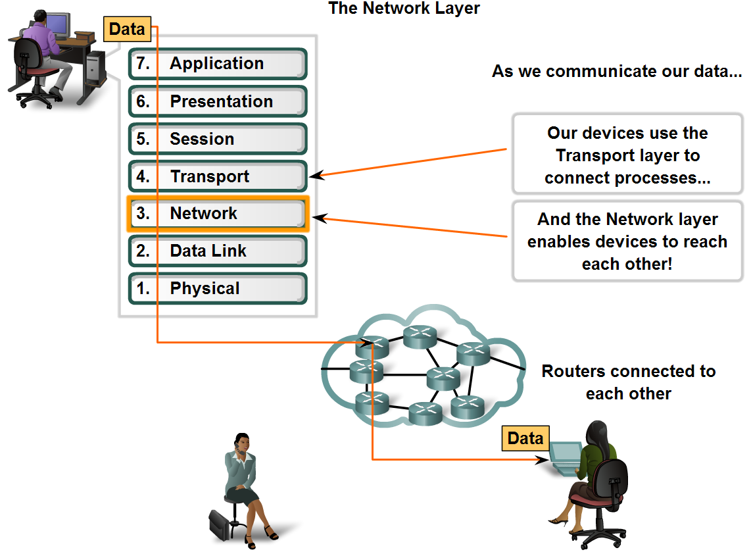
Network Layer Protocols
Define the basic role of the Network Layer in data networks

Slide 7
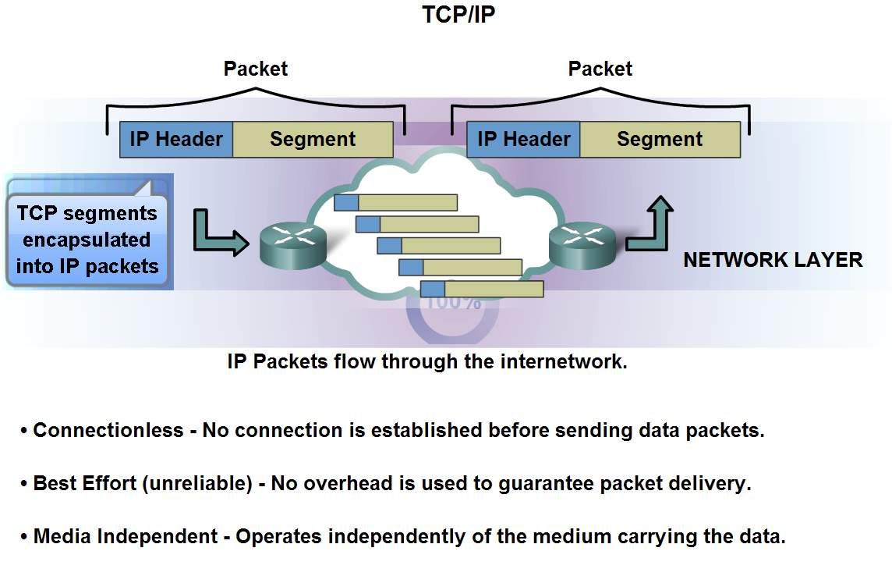
Network Layer Protocols
Identify the basic characteristics and the role of the IPv4 protocol

Slide 8
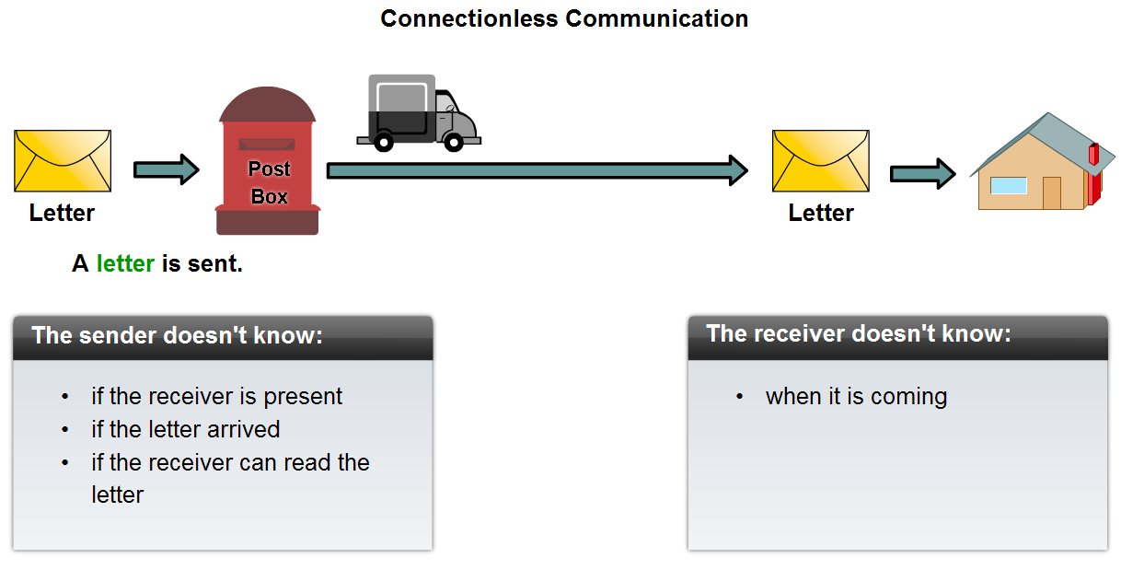
Network Layer Protocols
Describe the implications for the use of the IP protocol as it is connectionless

Slide 9
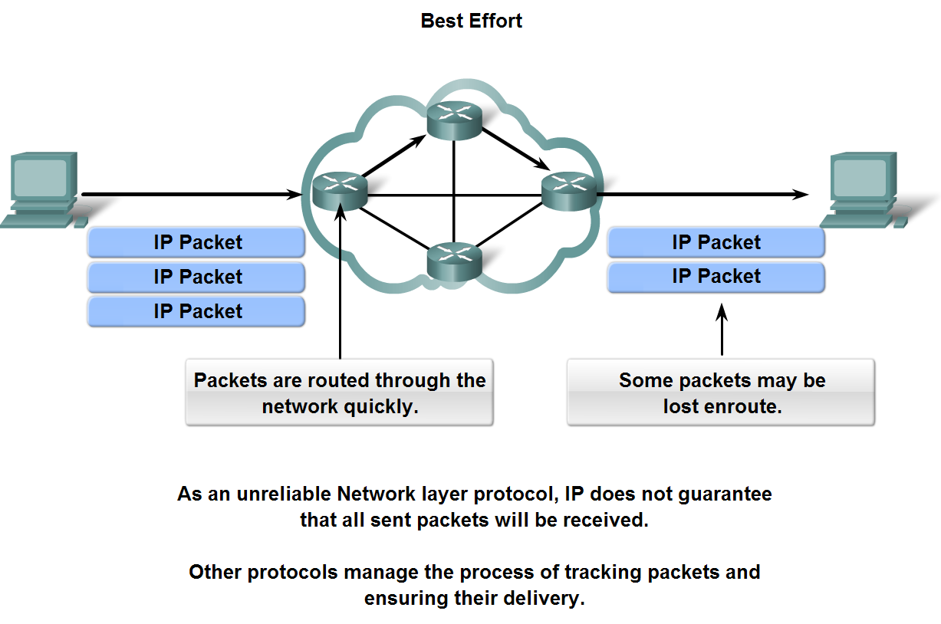
Network Layer Protocols and Internet Protocol (IP)
Describe the implications for the use of the IP protocol as it is considered an unreliable protocol

Slide 10
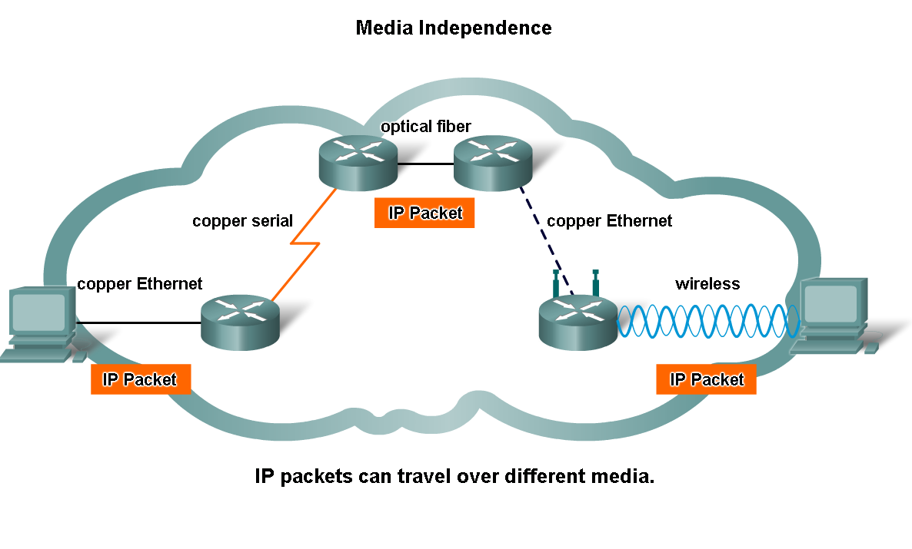
Network Layer Protocols
Describe the implications for the use of the IP as it is media independent

Slide 11
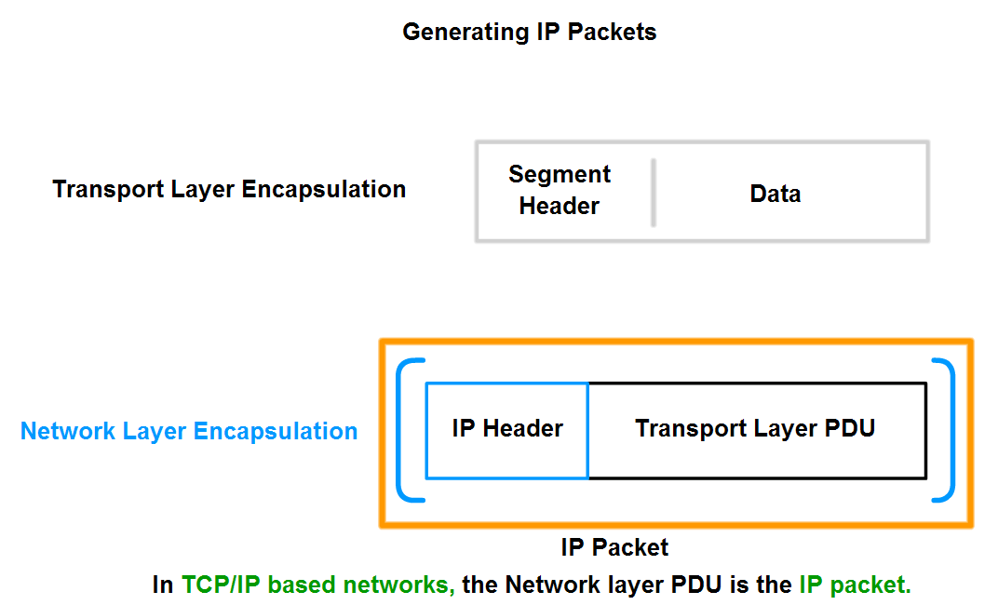
Network Layer Protocols
Describe the role of framing in the Transport Layer and explain that segments are encapsulated as packets

Slide 12

Network layer in an internetwork

Slide 13

Network layer at the source, router, and destination

Slide 14

Network layer at the source, router, and destination (continued)

Slide 15

Note
Communication at the network layer in the Internet is connectionless.

Slide 16
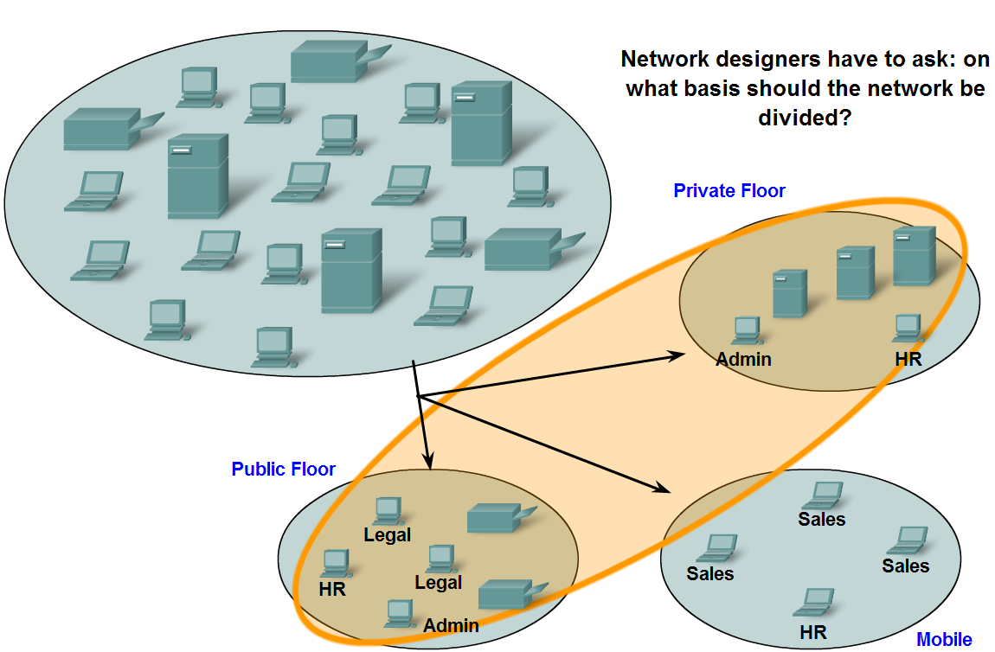
Grouping Devices into Networks and Hierarchical Addressing
List several different reasons for grouping devices into sub-networks and define several terms used to identify the sub-networks

Slide 17
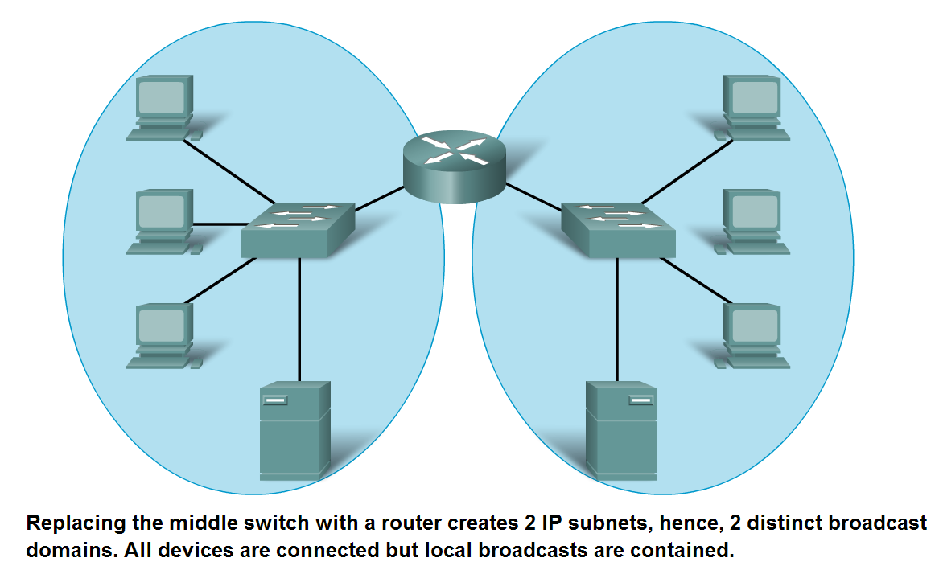
Grouping Devices into Networks and Hierarchical Addressing
List several ways in which dividing a large network can increase network performance

Slide 18
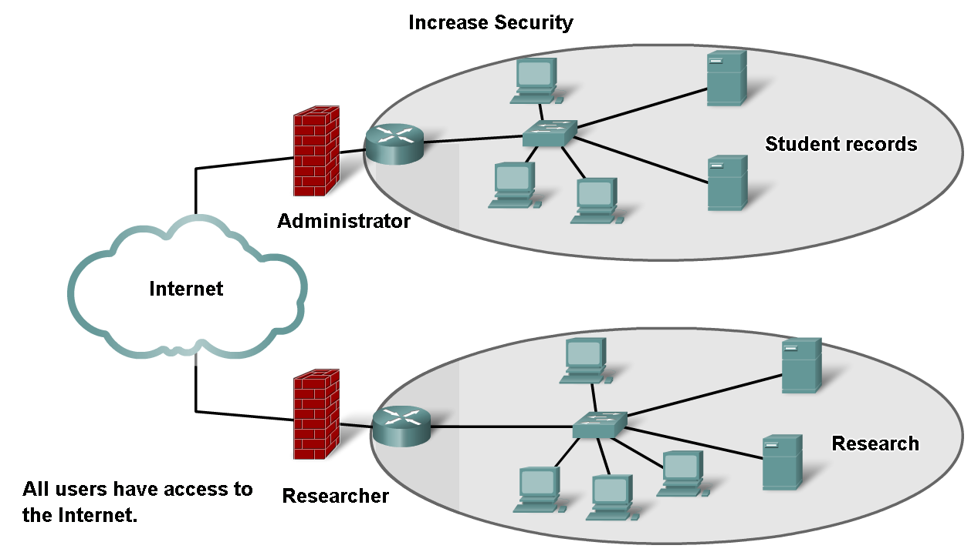
Grouping Devices into Networks and Hierarchical Addressing
List several ways in which dividing a large network can increase network security

Slide 19
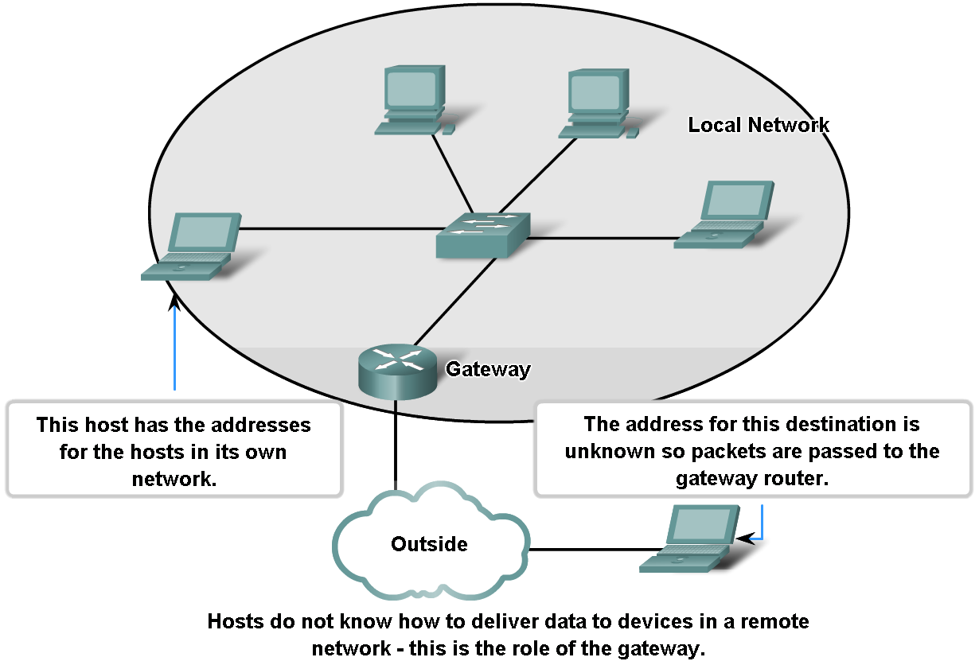
Grouping Devices into Networks and Hierarchical Addressing
Explain the communication problems that emerge when very large numbers of devices are included in one large network

Slide 20
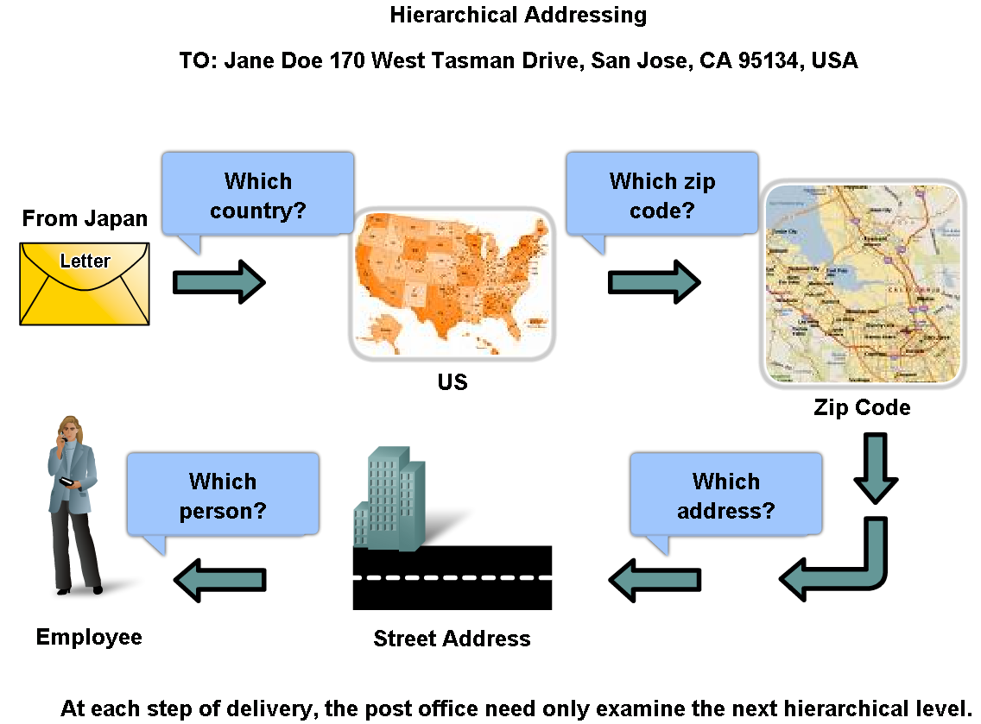
Grouping Devices into Networks and Hierarchical Addressing
Describe how hierarchical addressing solves the problem of devices communicating across networks of networks

Slide 21
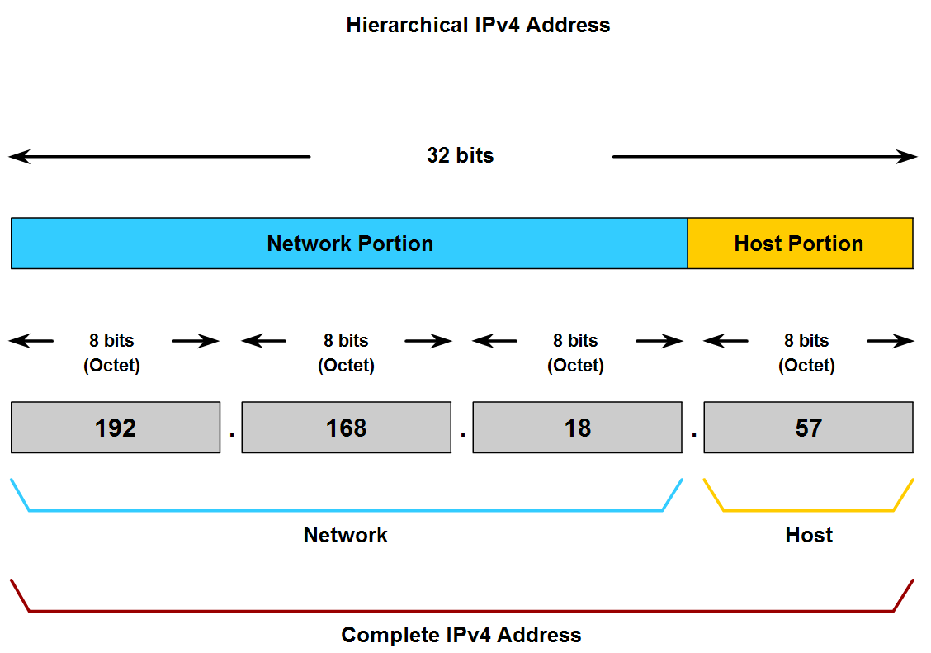
Grouping Devices into Networks and Hierarchical Addressing
Describe the purpose of further subdividing networks into smaller networks

Slide 22
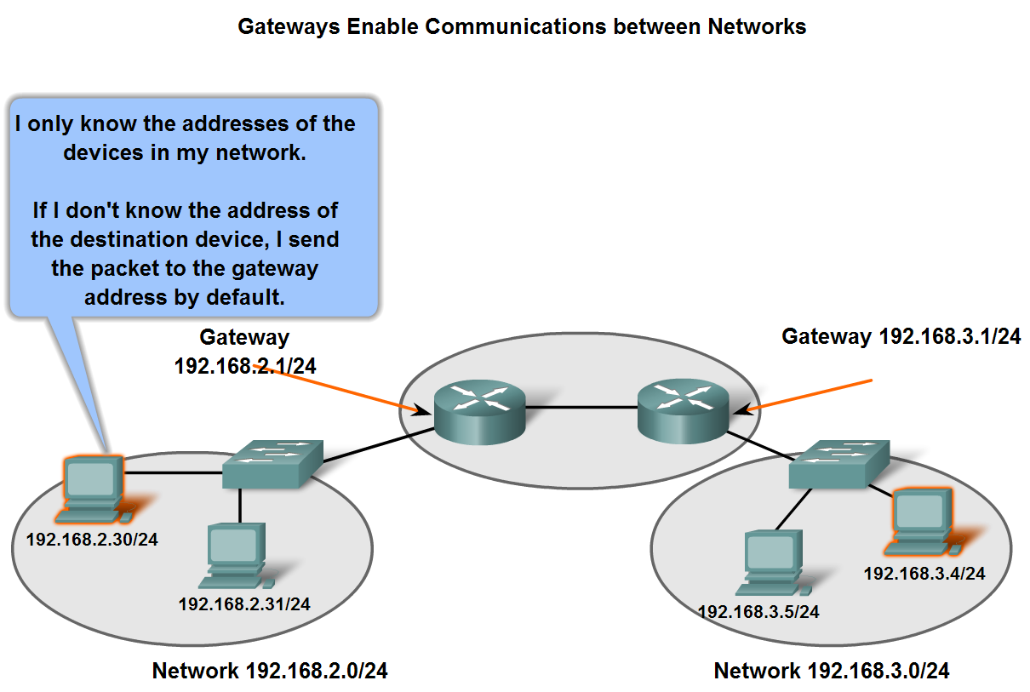
Fundamentals of Routes, Next Hop Addresses and Packet Forwarding
Describe the role of an intermediary gateway device in allowing devices to communicate across sub-divided networks

